Slide 1
AGILE
Project Development Mindset
Notes:
1

Slide 2
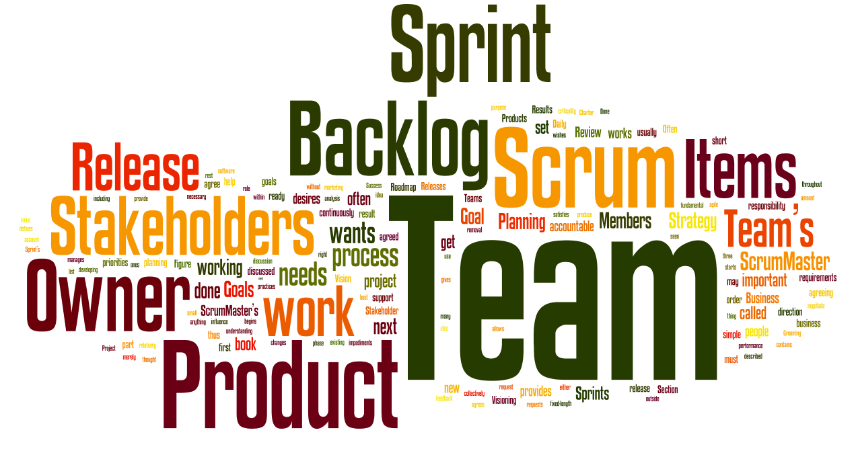

Slide 3
Business Challenges
Shorter Delivery Cycles/Long Term Customer Commitments
Customers looking at faster delivery cycles
Adaptive solutions to meet customer’s ever changing business environment
Long term customer commitments
Time to Market
More Features/ Better Quality
Competitive feature game
Maintain high Production Quality
Improve Usability
Address New Markets/ Honour Old Customers
Become present in new Markets and segments
Deliver as promised
Improve customer satisfaction & ensure retention
How to go about it!

Slide 4
The Stage
Identify Improvement Areas
Finding the problem & root cause
Maintain focus on your core competencies
Work towards the end solution, keep intermediate goals
Start rolling the Ball
Keep things simple
Do your analysis before doing anything
Institutionalize & Adopt Change
Train and facilitate teams
Delegate & Empower
Create Accountability with Responsibility
The AGILE WAY !

Slide 5
When to use RAD
Reasonably well-known requirements
User involved throughout the life cycle
Project can be time-boxed
Functionality delivered in increments
High performance not required
Low technical risks
System can be modularized

Slide 6
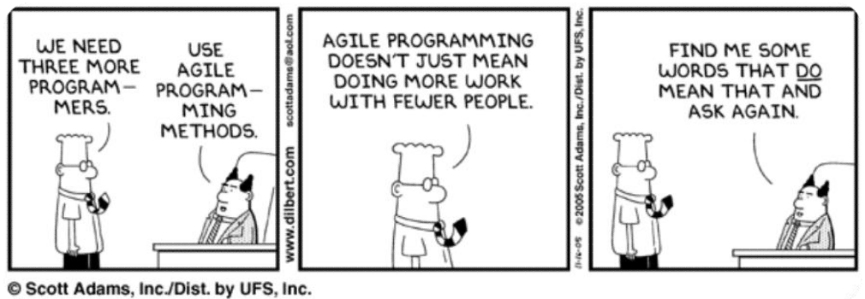
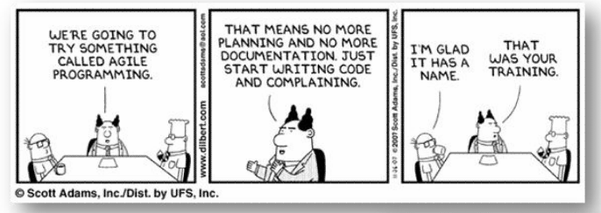
Agile is popular

Slide 7










Losing information
1
2
3
4
5
6
7
8
9
10
1. Promise Made by Sales
6. This is document
2. Requirement Metioned by Customer
7. This is Installation Package
3. Requirement Understanded by Project Manager
8. This is Cost
4. Design given by Designer
9. This is Support
5. Coding performed by programer
10. This is What Really Want by Customer

Slide 8
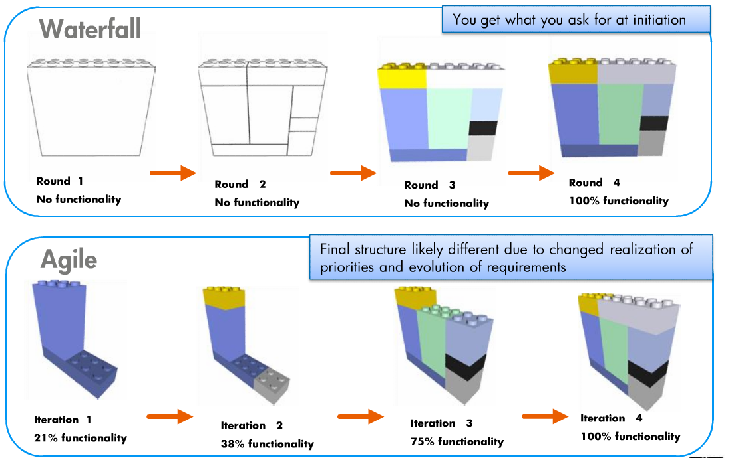
Waterfall VS. Incremental

Slide 9
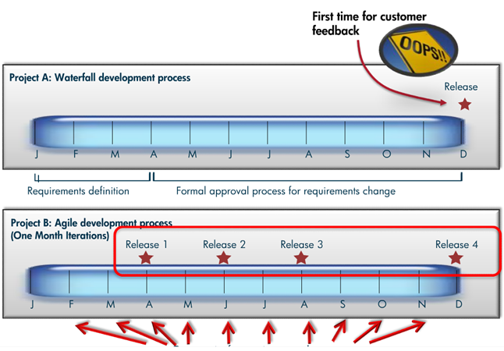
Waterfall vs. Incremental (agile)- cont
Manage Change

Slide 10
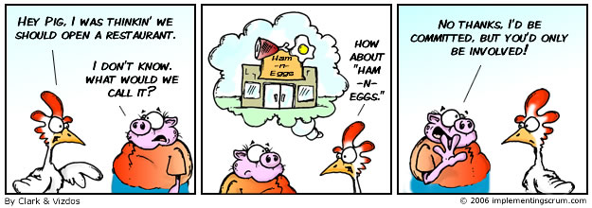

Slide 11
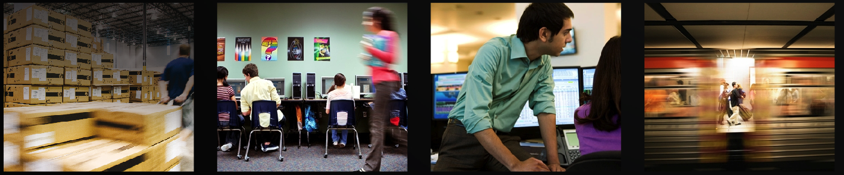

Agile manifesto
1
2
3
4
Individuals and interactions over processes and tools
Customer collaboration over contract negotiation
Working software over comprehensive documentation
Responding to change over following a plan

Slide 12
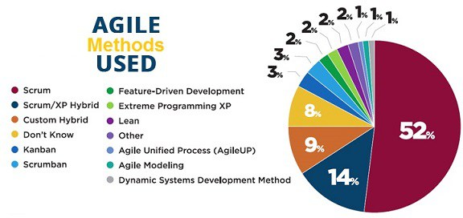
Agile methods
Scrum
Extreme Programming
Kanban
Lean Development
Feature-Driven Development (FDD)

Slide 13
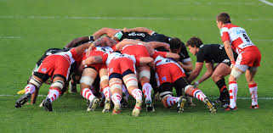

Slide 14

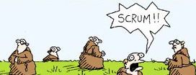

Understanding SCRUM
What is SCRUM?
Agile Way of Project Management.
Work in your functional team
A team-based collabrative approach
Scrum Call
Iterative & incremental development
Collaborative Planning & Review
Always focus to deliver “Business value”
Restart your work again

Slide 15
PRINCIPLES OF SCRUM
Welcome changing requirements, even late in development
Deliver Valuable Working Software frequently. This is our primary measure of progress.
Early visibility to Business
Product owners (Business) and developers must work together daily throughout the project, at a sustainable pace
Inspect and adapt
Self Organizing teams

Slide 16
SCRUM Rules
You Have No Hierarchical Role; You Are an Expert
You are Part of the Team
The Team’s Goals are your Goals; You committed to them
Do Whatever you can for the Team to meet its Goals
Forget Role Thinking!
There Is No Individual Failure – The Team Fails!
There Is No Individual Success – The Team Succeeds!
Done is done; as a team you completed these activities
You let the team down if you’re late to meetings

Slide 17
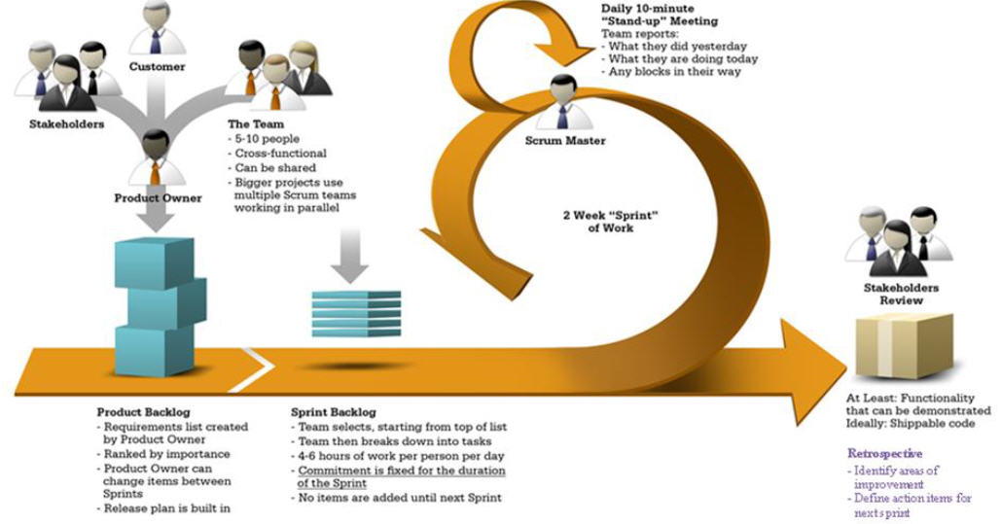

Slide 18
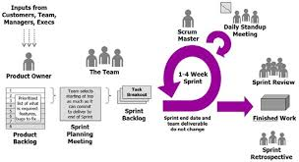

Slide 19


SCRUM Team
Responsible for committing to work
Self-organizing
Authority to do whatever is needed to meet commitment
Ideal core team size 7
Demonstrates Sprint output as Product Increment
Business Owner, user community and stakeholders are welcomed
Scrum Master
Chicken and Pigs
Product Ownerr
Scrum
Roles
Team Members
Scrum Master
Business User
Community

Slide 20
Product Owner
The Product Owner represents stakeholders and is the voice of the customer.
Product Owner is accountable for ensuring that the team delivers value to the business.
writes customer-centric items (typically user stories),
prioritizes them, and
adds them to the product backlog.
Scrum teams should have one Product Owner.
May also be a member of the development team
Not recommend this person be Scrum Master.

Slide 21
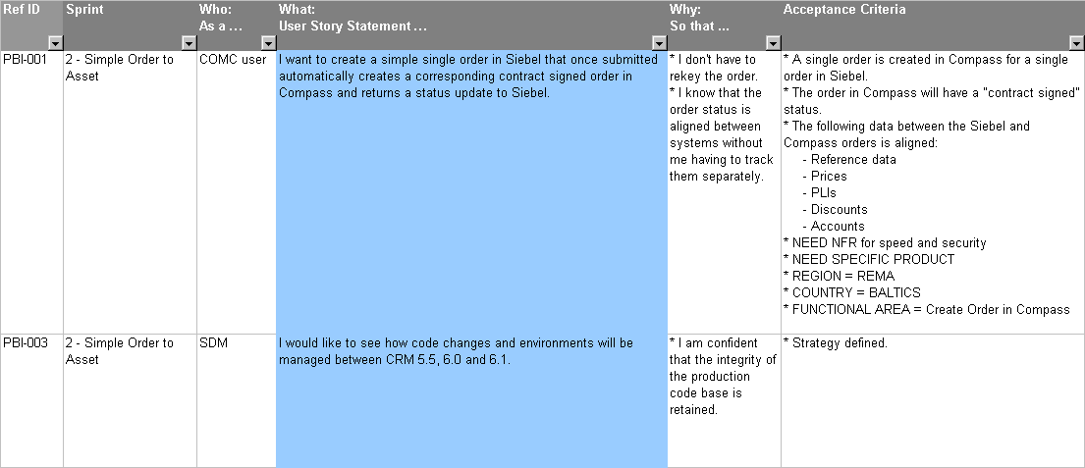
PRODUCT BACKLOG

Slide 22
In the Product Backlog
Task
Story
Epic
Feature
Theme

Slide 23
User Story
As a ……….,
I want ………..,
So that I can ……… “story value”

Slide 24
User Story
Work on all stories include all phases:
Analysis/Definition
Design
Build
Test
Verify
Stories should be small enough to complete in 1 or 2 days

Slide 25
Principle of create User story
Independent
Negotiable
Valued
Estimable
Small
Testable

Slide 26
Product backlog
Backlog item | Estimate/ Weight
Allow a new user to make sign up | 3
As a registered user , I want to enter/choose my mood , so that ….etc. | 5
As a shop owner, I want to change the interests / offers, so that it appears to all users with suitable mood. | 3
As a mood enter user , I can view my friends moods and interests | 8
Improve exception handling | 8
... | 30
... | 50

Slide 27
Typical fields
ID
Auto-incremented number
Short, descriptive name
Importance or priority
Anything else of note
Details discovered through discussion and conversation between the team and product owner
Estimate
Acceptance Test
Detail/conversation
Condition of satisfaction being placed on the system
How to demonstrate? Example ?
Effort of story points, H/M/L
Relative and consistent
Importance to product owner
Name
Decomposed stories often use point technology

Slide 28

Product BackLog
The requirements
A list of all desired work on the project
Ideally expressed such that each item has value to the users or customers of the product
Prioritized by the product owner
Reprioritized at the start of each sprint
Ordered
Valued
Estimated
Product Backlog

Slide 29
SPRINT PLANNING
OFF-SHORE/ONSITE – through VC

Slide 30
Sprint Backlog
Individuals sign up for work of their own choosing
Estimated work remaining is updated daily
Any team member can add, delete or change the sprint backlog
Work for the sprint emerges
If work is unclear, define a sprint backlog item with a larger amount of time and break it down later
Update work remaining as more becomes known
Assignable
Small (1-16hours)
Team Estimated
Sprint Backlog

Slide 31
The Scrum Master
Represents management to the project
Responsible for enacting Scrum values and practices
Scrum Master can not be the team leader, but acts as a buffer between the team and any distracting influences.
Ensure that the team is fully functional and productive
Enable close cooperation across all roles and functions
Shield the team from external interferences

Slide 32
Scrum Team
The Development Team is responsible for delivering potentially shippable product increments at end of each Sprint.
Team = 3–9 people with cross-functional skills.
Team does actual work
(analyze, design, develop, test, technical communication, document, etc.).
Team is self-organizing, even though they may interface with project management organizations (PMOs).
Cross-functional
QA, Programmers, UI Designers, etc.
Members should be full-time
May be exceptions (e.g., System Admin, etc.)
Teams are self-organizing
Membership can change only between sprints

Slide 33
Ceremonies
Sprint Planning Meeting
SprintDays
Daily Scrum
Sprint Review Meeting

Slide 34


SCRUM and SPRINT Cycle
What did we do yesterday?
What are we doing today?
What are the impediments?
Pre-requisites
Sprint 1-n
Initial Product Backlog
Prioritised Backlog by Business Content Leads
Secured resources
Impediment Log (from previous Sprint)
SSprint
Planning Meeting
Daily Scrum
Daily activities
Update
Product
Backlog
Scrum Lifecycle
Product
Increment
Key Artefacts
Product Backlog
Product Backlog Burn down
Sprint Backlog
Sprint Backlog Burn down
Impediment Log
Process Maps (Case wise)
High Level Design
Sprint
Retrospective
Sprint Review
Product Owners
Scrum Roles
Scrum Master
Team Members
(Analysts, developers,
Designers)
Business User
Community

Slide 35
Sprint Planning
The Project Product Owner reprioritises the product backlog
The Product Owner and Scrum Team meet to determine the work that can be completed in the next sprint.
Work is selected from the top of the priority list by the Team.
The Product Owner and the Team establish a goal for the sprint
The Team is expected to select only work which they can commit to finishing (according to the definition of “DONE”)
Selected items are broken down into sprint backlog tasks
Team estimation is informed by performance on previous sprints, capacity for the forthcoming sprint and the relative complexity of the tasks required to deliver the Sprint Goal.

Slide 36
Sprint
A regular repeatable work cycle
Length defined by the team
Now companies sweet spot is 2 weeks
Sprint scope should not change
End goal is shippable increment of functionally
Not the entire workflow

Slide 37
Sprint BackLog
Tasks
Sunday
Monday
Tuesday
Wednes.
Thursday
Code the user interface
8
4
8
Code the middle tier
16
12
10
4
Test the middle tier
8
16
16
11
8
Write online help
12
Write the user account class
8
8
8
8
8
Add error logging and redirect
8
4

Slide 38
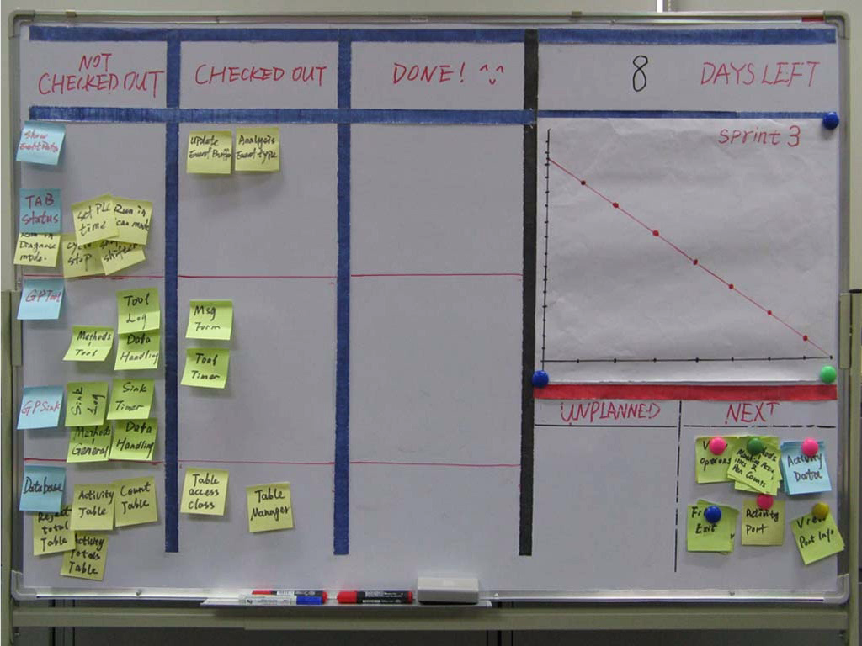
Task Board
Visible
Editable
Update Daily
Own By team

Slide 39


Product BackLog VS Sprint Backlog
Product Backlog | Sprint Backlog
Large | Small
More Business | More Technical
Product Owner | Team
User Story | Task
Before Sprint planning | During Sprint planning
As a wedding planner, I want to see photos of the hotels.
Code the logic funs. (8 hours)
Code the user interface (4)
Write test cases (4)
Code the foo class (6)
Update performance tests (4)

Slide 40
DONE CRITERIA
Area | Activity | Completion Status
Code | Developed against selected elements of the PBI design and build standards and peer reviewed. | 100%
Design | Detailed design incorporated in HLD document and reviewed and agreed by lead designer/architects | 100%
Testing | Unit Testing coverage (Error & defect free) | 100%
Testing | Functional Testing presented to and conducted by content lead and/or SME and/or Front Line Business Users | 100%
Testing | Usability Testing presented to and conducted by content lead and/or SME and/or Front Line Business Users | 100%

Slide 41
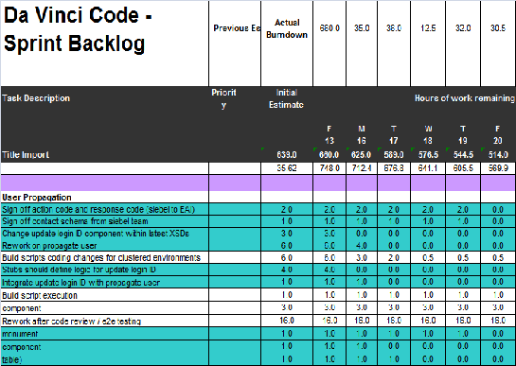
SPRINT Backlog contents
The list emerges during Sprint planning
The Sprint backlog is a list of tasks that defines a Team's work for a Sprint
The tasks are what the Team has defined as being required to turn committed Product Backlog items into system functionality
Task size: 1-16 hours
Estimated as a team
Each task identifies the estimated amount of work remaining for the Sprint
Tasks are not assigned, the team members pick themselves
41

Slide 42
Daily Scrum meetings
Same Time
Same Place
Every Day
Everyone Participates
Everyone Stands
No Design (Talk About it After the Meeting)
Daily meeting
15 minutes
Standup (to avoid too long meeting)
Not for problem solving
Three questions:
What did you do yesterday?
What obstacles are in your way?
What will you do today?
Update Sprint Burn down
Update Impediment log

Slide 43
Daily Scrum Meetings
Offshore and Scrum
Part of scrum team will be located offshore
Offshore team will work closely with onsite teams through various SPRINT phases
Scrum Master Responsibilities
Ensure self and team participates in daily scrum over teleconference
Ensure that burn down charts of the sprint backlog is up-to-date
Note impediments in his/her capability and address them
Ensure participation in the daily Scrum of Scrums (SoS)
Bring to the notice of SoS, the impediments that are not in his/her capability of solving

Slide 44
Impediment log
Any issue that prevents the Scrum Teams from being able to progress an activity should be placed on the Impediment Log.
Any issue that is highlighted and known to impact the Scrum Teams at a future date or future sprint, should be placed on the Impediment Log
It is the responsibility of Scrum Master to resolve impediments locally. If the impediments cannot be resolved locally, then these need to be raised at the Scrum-of-Scrum daily meetings for escalation
Anyone in the Team can raise an Impediment identifying a blocker to project progress.

Slide 45
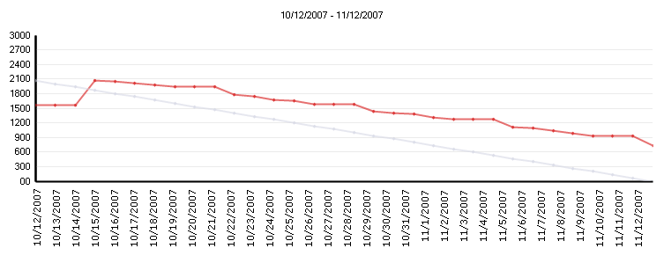
SPRINT Burn Down
Hours Remaining by Date
Updated daily by Scrum Master (uploaded to Share point)
Previous days’ Sprint Burn down is brought along to daily Scrum of Scrums meeting
How much effort is left to be done
Visible to all the team (printed off and placed on Scrum team whiteboard)

Slide 46
SPRINT Review
The team presents to management, customers, users and Product Owner the product increment that has been built during the Sprint
Sprint goal
Product Backlog committed
Product backlog completed
The team tells story of its journey during the Sprint – honestly!
The majority of the Sprint Review is spent with Team members presenting functionality, answering stakeholder questions regarding the presentation
At end of presentation, stakeholders are polled, one by one to get their impressions, any desired changes, and priority of these changes.
Product Owner discusses with Team about potential rearrangement of the Product Backlog based on the feedback.

Slide 47
SPRINT Review Process
The Team should not spend more than one hour preparing for Sprint Review.
Functionality that isn't "Done" cannot be presented.
Functionality should be presented and executed from development environment
Stakeholders are free to voice any comments, observations, or criticisms regarding the increment of potential shippable product functionality
Stakeholders can identify functionality that wasn't delivered or wasn't delivered as expected and request that such functionality be placed in the Product Backlog for prioritisation.
Stakeholders can identify any new functionality that occurs to them as they view the presentation and request that the functionality be added to the Product Backlog for prioritisation.
The Scrum Master should determine number of people who expect to attend the Sprint Review meeting and setup the meeting to accommodate them.
At the end of Sprint Review meeting, Scrum Master announces the place and date for next Sprint Review to Product Owner and stakeholders.

Slide 48
SPRINT Retrospective
Meeting at the end of each sprint, facilitated by Scrum Master, where the team review the sprint just completed and discusses what improvements they would like to make to the next sprint to make it more productive.
Process Improvements made at the end of every sprint
All team members identify what went well and what can be improved
Processes
Communication
Environment
Artefacts
Tools
Team dynamics
Team devises their own solutions to problems
Assists with team formation and bonding as conflicts identified quickly and thus can be dealt with

Slide 49
Project --Development Process
PRODUCT
BACKLOG
New Sprint Plan +Increment
SPRINT
30 DAYS
SPRINT 2
New Sprint Plan +Increment
SPRINT PLANNING MEETING
SPRINT
30 DAYS
SPRINT 3
SPRINT
GOAL
SPRINT
GOAL
SPRINT
30 DAYS
Daily Scrum
Daily Scrum
SPRINT
BACKLOG
SPRINT
GOAL
SPRINT
BACKLOG
Daily Work
Daily Work
IMPEDIMENTS
Daily Scrum
SPRINT
BACKLOG
Daily Run
through out sprint``
IMPEDIMENTS
Burndown
Daily Work
PRODUCT
INCREMENT
PRODUCT
INCREMENT
IMPEDIMENTS
SPRINT REVIEW MEETING
Burndown
PRODUCT
INCREMENT
SPRINT REVIEW MEETING
BurdDown Rate
SPRINT REVIEW MEETING
Product backlog
BurdDown Rate
49
Time
Notes:
49
So, why are we using a Chicken and Pig?
The story above, as weird as it is, helps me -- and others -- explain two of the three key roles in Scrum. I am amazed that the Human Resource Departments of many companies I consult with have not shut down this example; it is probably only a matter of time. This is still the best example I know of to explain the roles, and this is what our cartoon series reflects.
The basic premise of the Chicken and the Pig can be seen from the cartoon example above. They include two of the three roles in Scrum. Remember that, as it easy to forget. The other role is the Scrum Master, who will be introduced later in this series. Oh... and hang with me a second... there is someone called a Product Owner (who is a really a Pig in disguise).
Here is an easy definition of the Chickens versus Pigs.
A Pig is someone who has skin in the game. Mike Cohn aptly refers to the people in that role as, "Having their Bacon on the line." Pig roles are considered core team members. Performers. People who "do" work. Get it?
A Chicken is someone who has something to gain by the Pigs performing, but in the end, really do not contribute day to day to "getting things done." Their "eggs" are a renewable resource, and many get laid (eggs that is).
I get asked the following question by many people when starting to use Scrum: "Can I be a Pig and Chicken at the same time?"
No. You cannot be a Pig and a Chicken at the same time. This is something I work with middle managers who struggle with this on a daily basis. The concept takes coaching, and constant [gentle] reminders that they cannot be a Pig/Chicken.
We will examine this and other issues in a future cartoon series, as this is fun to see happen (sometimes sad WHILE it is happening, but funny to imagine).

Slide 50
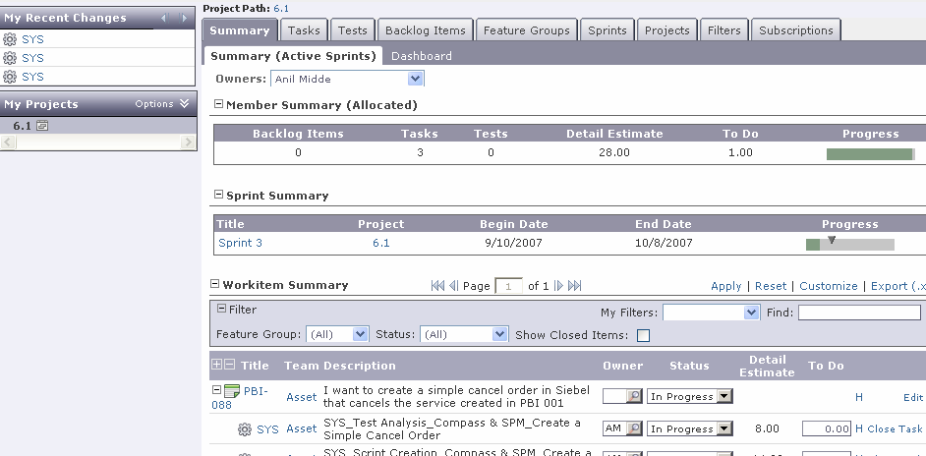
Tools -SPRINT UPDATES

Slide 51
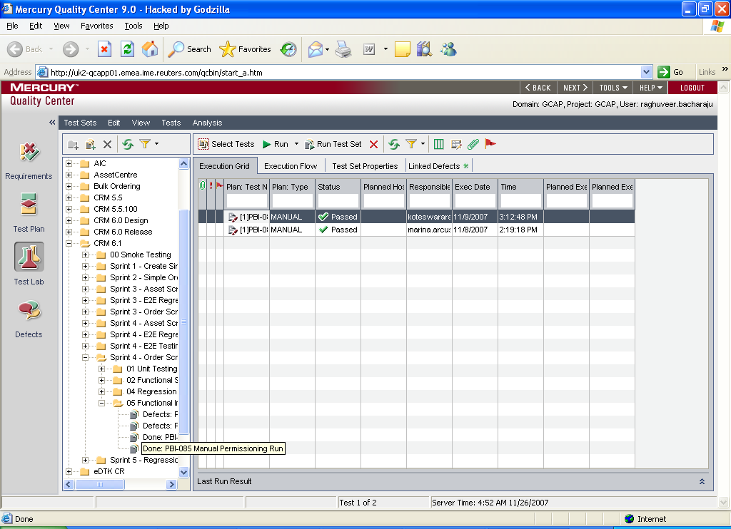
Tools -TEST UPDATES – Quality Centre

Slide 52
Agile manifesto
1
2
3
4
Individuals and interactions over processes and tools
Customer collaboration over contract negotiation
Working software over comprehensive documentation
Responding to change over following a plan

Slide 53
Roles
Artifacts
Product owner
Scrum Master
Team
Product backlog
Sprint backlog
Burndown charts
Ceremonies
Sprint
Sprint planning
Sprint review
Sprint retrospective
Daily scrum meeting

Slide 54
Roles
Artifacts
Product owner
Scrum Master
Team
Product backlog
Sprint backlog
Burndown charts
Ceremonies
Sprint
Sprint planning
Sprint review
Sprint retrospective
Daily scrum meeting

Slide 55
Roles
Artifacts
Product owner
Scrum Master
Team
Product backlog
Sprint backlog
Burndown charts
Ceremonies
Sprint
Sprint planning
Sprint review
Sprint retrospective
Daily scrum meeting

Slide 56
Roles
Artifacts
Product owner
Scrum Master
Team
Product backlog
Sprint backlog
Burndown charts
Ceremonies
Sprint
Sprint planning
Sprint review
Sprint retrospective
Daily scrum meeting

Slide 57
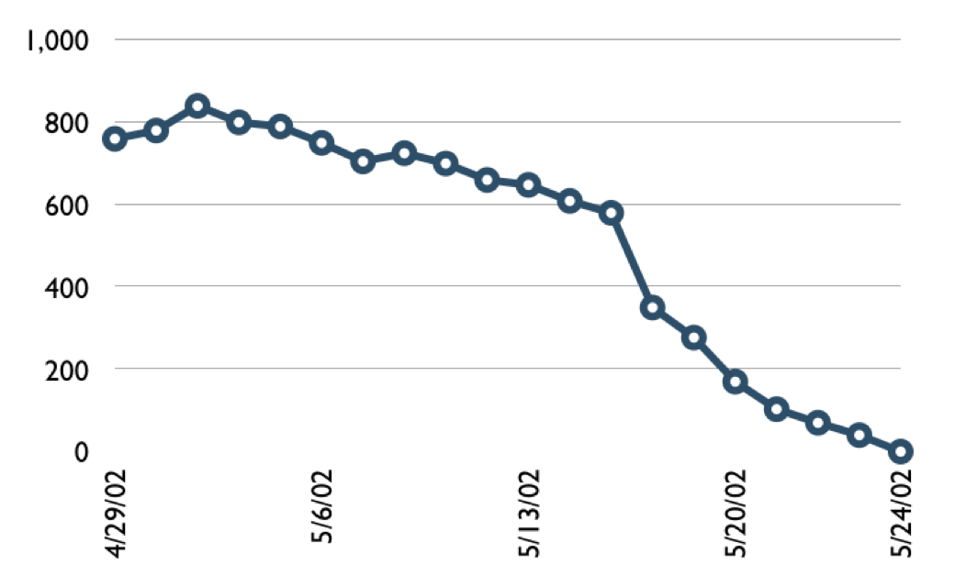
Burndown charts
Effort Left
Date

Slide 58
Brundown Charts
Update daily, usually during the daily stand-up
Represent the amount of work remaining
Different approaches to create burndown charts
Estimated remaining time
Track done

Slide 59

Burndown charts
Tasks
Mon
Tues
Wed
Thur
Fri
Code the user interface
8
4
8
Code the middle tier
16
12
10
7
50
Test the middle tier
8
16
16
11
8
40
Write online help
12
30
Hours
20
10
0
Mon
Tue
Wed
Thu
Fri

Slide 60
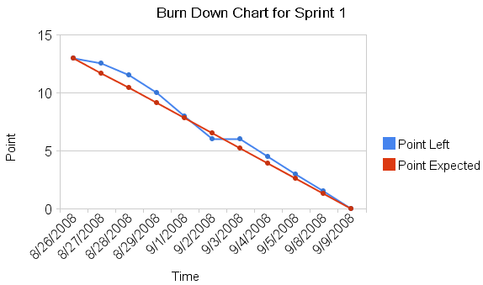
Burndown charts
Possible over commitment
Possible Under commitment
Commitment achieved. Keep this velocity for next Sprint

Slide 61



Sprint Planning
Team capacity
Sprint planning meeting
Sprint prioritization
Sprint goal
Product backlog
Analyze and evaluate product backlog
Select sprint goal
Business conditions
Sprint planning
Decide how to achieve sprint goal (design)
Create sprint backlog (tasks) from product backlog items (user stories / features)
Estimate sprint backlog in hours
Current product
Sprint
backlog
Techno-logy

Slide 62
Post to Sprint Planning
The SM Presents the team commitments to the PO
The PO can re-prioritize based on the commitments
If PO requests change then the sprint plan will be reworked
If no changes are required then the team commits to the work
note : no adjustments during sprint but only disasters.

Slide 63
Sprint Planning
How much work can fit into the sprint :
Can’t postpone new implementation
Can’t postpone technical debt
Can’t postpone support
Capacity Allocation

Slide 64
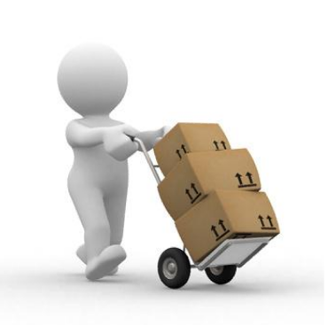
Sprint review
Team presents what it accomplished during the sprint
Typically takes the form of a demo of new features or underlying architecture
Informal
2-hour prep time rule
No slides
Whole team participates
Invite the world

Slide 65

Sprint retrospective
Periodically take a look at what is and is not working
Typically 15–30 minutes
Done after every sprint
Whole team participates
Scrum Master
Product owner
Team
Possibly customers and others

Slide 66
Agile Principles
Customer satisfaction through early and continuous software delivery – Customers are happier when they receive working software at regular intervals, rather than waiting extended periods of time between releases.
Accommodate changing requirements throughout the development process – The ability to avoid delays when a requirement or feature request changes.
Frequent delivery of working software – Scrum accommodates this principle since the team operates in software sprints or iterations that ensure regular delivery of working software.

Slide 67
Agile Principles
Collaboration between the business stakeholders and developers throughout the project – Better decisions are made when the business and technical team are aligned.
Support, trust, and motivate the people involved – Motivated teams are more likely to deliver their best work than unhappy teams.
Enable face-to-face interactions – Communication is more successful when development teams are co-located.
Working software is the primary measure of progress – Delivering functional software to the customer is the ultimate factor that measures progress.

Slide 68
Agile Principles
Agile processes support a consistent development pace – Teams establish a repeatable and maintainable speed at which they can deliver working software, and they repeat it with each release.
Attention to technical detail and design enhances agility – The right skills and good design ensures the team can maintain the pace, constantly improve the product, and sustain change.
Simplicity – Develop just enough to get the job done for right now.

Slide 69
Self-organizing teams encourage great architectures, requirements, and designs – Skilled and motivated team members who have decision-making power, take ownership, communicate regularly with other team members, and share ideas that deliver quality products.
Regular reflections on how to become more effective – Self-improvement, process improvement, advancing skills, and techniques help team members work more

Slide 70
Sprint retrospective
What to start doing
What to stop doing
What to continue doing

Slide 71

Q&A
Thank You

